Slide 1
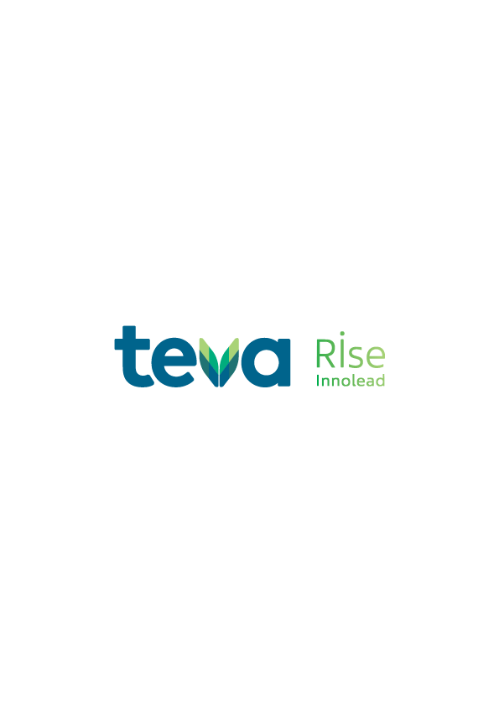
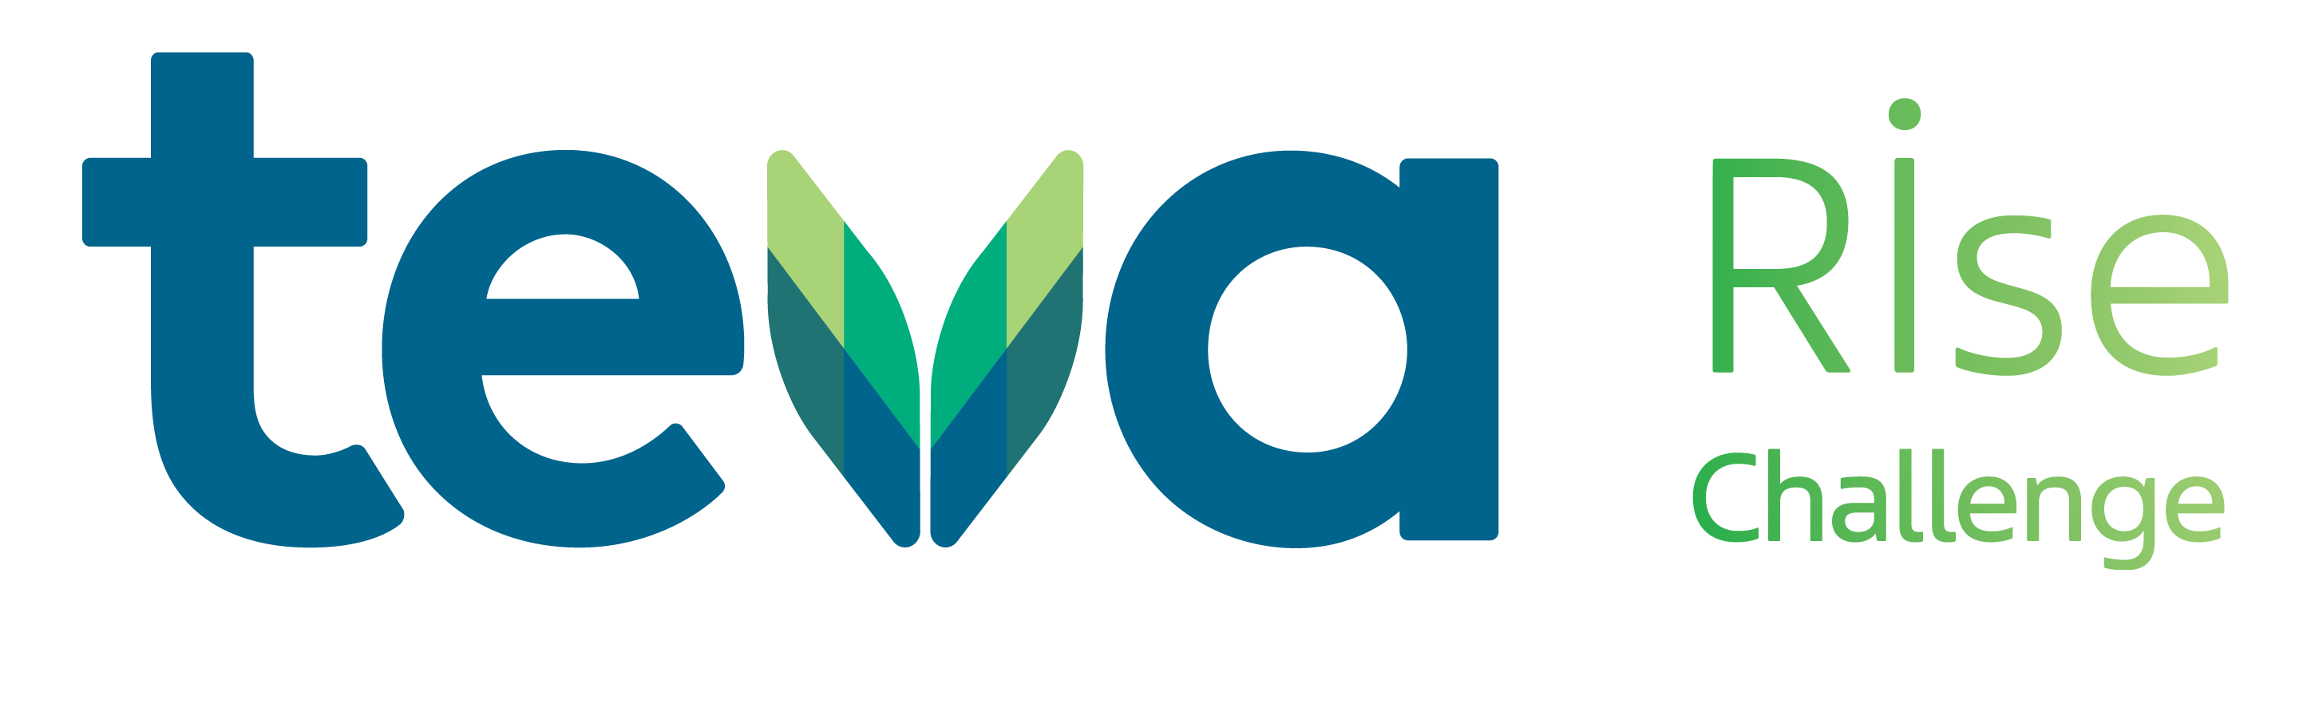




Rise - Umbrella of innovation solutions

Slide 2

Our bridge for bringing tech innovation to global impact
Dec 2025, Intro
www.tevarise.com

Slide 3











And leverage The synergy between Teva and the ecosystem
Systematically seeking new science, technologies and talent to strengthen our R&D and pipeline
New Talent
Bioinnovation Student Fellowship & Mentorship
New Science
New Technology

Slide 4



An open Innovation Initiative, accelerating our Pivot to Growth strategy by connecting Teva’s unmet challenges with disruptive tech solutions at global scale
3 |

Slide 5



Our goals for disruptive tech implementation:
Accelerating drug development
We focus on the entire value chain,
to create a systemic impact
Operational efficiencies & S.C
Commercial growth and efficiencies
4 |

Slide 6

The Future starts here
Rise with us!

